Slide 1
Norton Radstock AGM
Monday 28th April 2025 11.00hrs

Slide 2
Welcome – a little preparation
  Proxy forms to Dafydd by 10.30hrs please
  Hearing loop is available – switch your hearing aid to the T position (temporarily out of order)
  Phones to silent please
  All documents are on the website norrad@u3asites.uk
  Some printed copies available – please ask if unsure
  Meeting to start promptly at 11.00hrs

Slide 3
Agenda
  Welcome and Apologies.
  To note Standing Orders for the AGM.
  Minutes of the AGM on 29th April 2024
  Matters arising not covered by this Agenda.
  Chair’s Report.
  Treasurer’s Report.
  Approval of Accounts & Approval of Auditors for 2025.
  Election of Officers & Committee.
  Resolutions submitted in accordance with the Constitution.
  Any Other Business.
  Date of 2026 Annual General Meeting.

Slide 4
Priorities
Recruitment
Finance
Policies
Contingency Planning and Building Resilience
Efficiencies

Slide 5
Recruitment results
2024
2025
43 new members during the year
225 members 31/03/24
29 new members up to 23rd April
223 members 31/03/25
231 members 23/04/25

Slide 6
The Future of our u3a
Recruitment remains a priority
We expect a turnover of 10% – 20% of members per year
How can you help with recruitment?
Need more groups to form, to promote interest and variety
How can you help in groups?
Need more members willing to join our committee
Succession planning needed, at all levels

Slide 7
3rd Age Principle
Anyone not working full time
You do not need to be a specific age
Self-help Principle
Learning is for enjoyment
No distinction between learners and teachers
We are not a formal education provider
Mutual Aid Principle
Everything is funded by membership subscriptions
We are all volunteers
By the members, for the members

Slide 8
Any Questions?

Slide 9
Finances
2023-24
Grahame Lacey (Treasurer)

Slide 10
  Year End 2023 – 24:
  £756 surplus on Current account
  £12,341 in Reserve a/c (£4,326 ring-fenced)
  = £8,015 balance
  Interim Finances:
  (1st Nov ‘24 to 31st March ’25)
  Current a/c: £3,863
  Forecast surplus: £568
  Reserve a/c: £9,500
  (£4,750 ring-fenced)
  = £4,750 balance remaining

Slide 11
Risks 2024-25
Key risks:
* Dramatic fall in membership (low risk)
* Inability to form a viable committee (medium risk)
* Closure/ change of management/ change of use of Somer Centre (low risk)
*Repeat of a pandemic/epidemic (low risk)

Slide 12
Liabilities 2024-25
Core liabilities (in event of emergency, etc) = £3,200
Mitigation: Emergency Fund reserve = £4,750
This is more than sufficient to meet our liabilities should the need arise.

Slide 13
Any Questions?

Slide 14
Election of Trustees (Officers)
Chair – Rosemary Lovell
Vice-Chair – No Nominations
Business Secretary – Dafydd Evans
Treasurer – Grahame Lacey

Slide 15
Election of Trustees (Committee Members)
Margaret Burdon
Carol Channon
Ethne Dando
Marjorie Gilson
Mary Miller
Felicity Taylor
Mark Woodbury

Slide 16
Resolution
To return the membership fee to £15 for
2026, as the subsidised fee of £5 was for
one year only.
Proposed by Grahame Lacey
Seconded by Rosemary Lovell

Slide 17
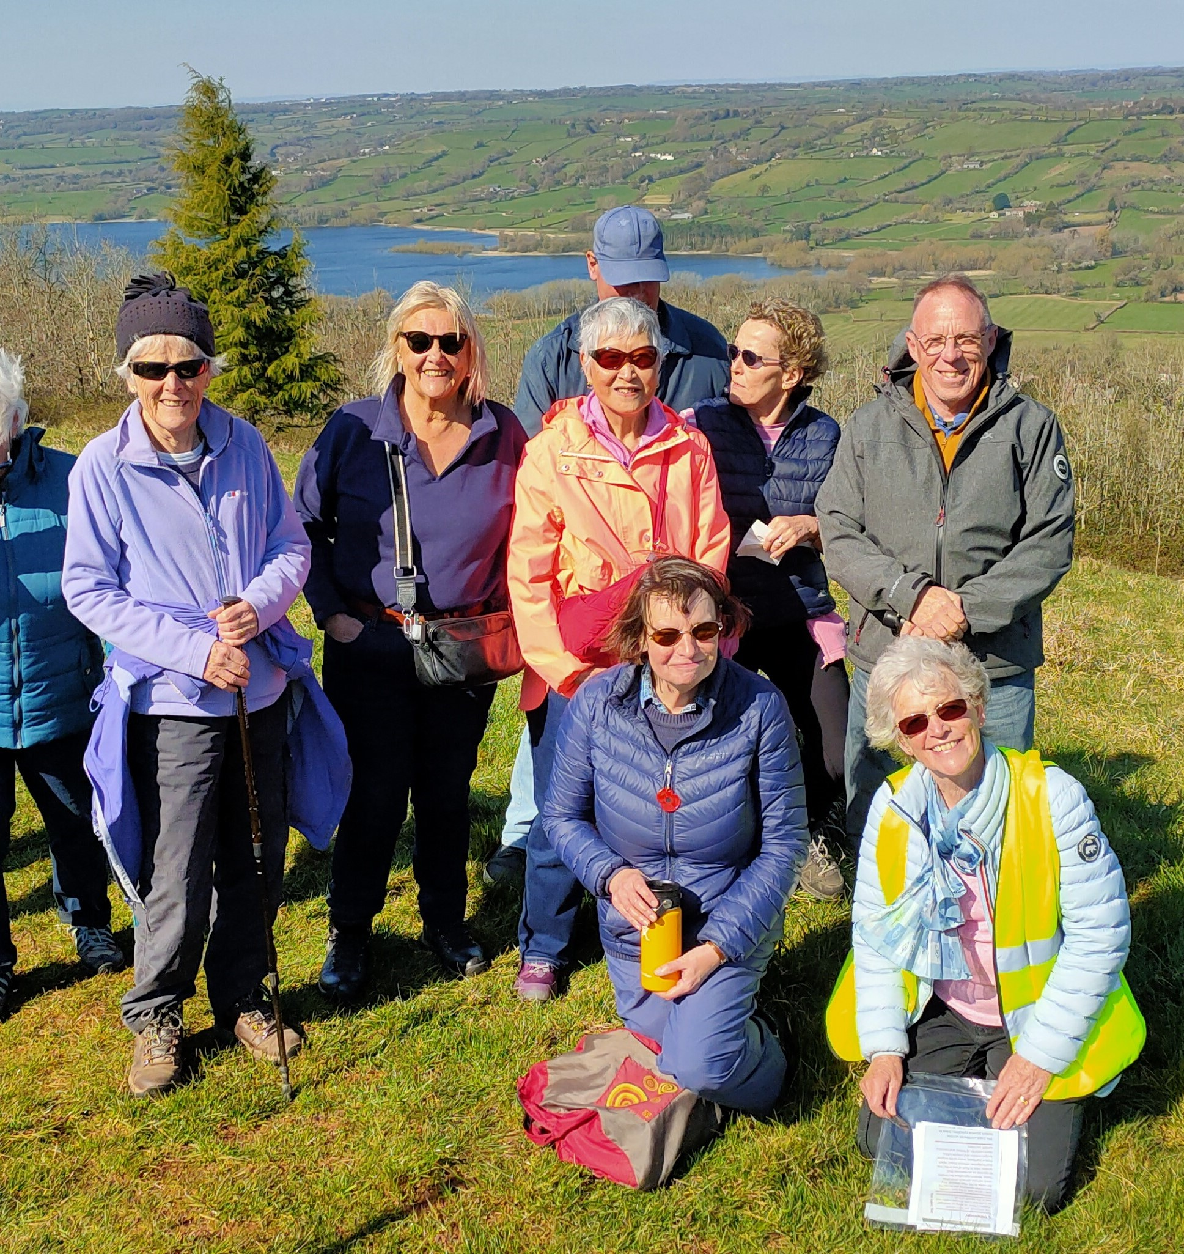
Keep up to date with events, news and groups – visit our website
norrad.u3asite.uk
or search online for “u3a Midsomer Norton”

Slide 18
u3a
  156 Blackfriars Road
  London, UK
  SE1 8EN
Contact u3a office
  Tel: 020 8466 6139
  Email: info@u3a.org.uk
  u3a.org.uk
  facebook.com/u3auk
  instagram.com/u3auk

